Slide 1
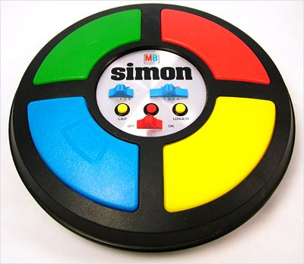
Arduino Says
By: Deveshwar, Gerald

Slide 2
How Arduino Says is Played
Arduino plays a sequence of lights
Player must replicate that sequence of lights
If the player incorrectly replicates the sequence, player has a certain number of lives left to keep playing.
If player correctly replicates the sequence, points are gained.
Game progressively gets more difficult

Slide 3
Information and Technology
We took our knowledge of the Arduino Circuit Playground and of the capacitive touches to give the Arduino intelligence to interpret and process information.
The Arduino is now its “own person” and can interact with the player by using led lights and sounds.
The Arduino uses digital write and read to read input and output from the capacitive touches.

Slide 4
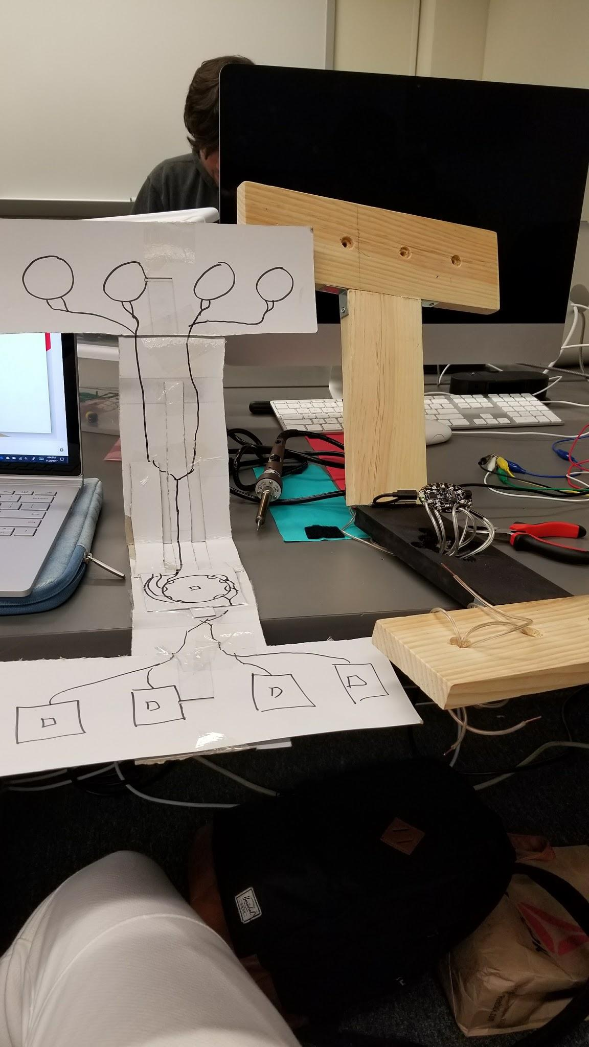
Prototype Design
To the left is the cardboard cut our blueprint/prototype layout.
On the right is the first prototype where we tested hole sizes and struggled with cable management

Slide 5
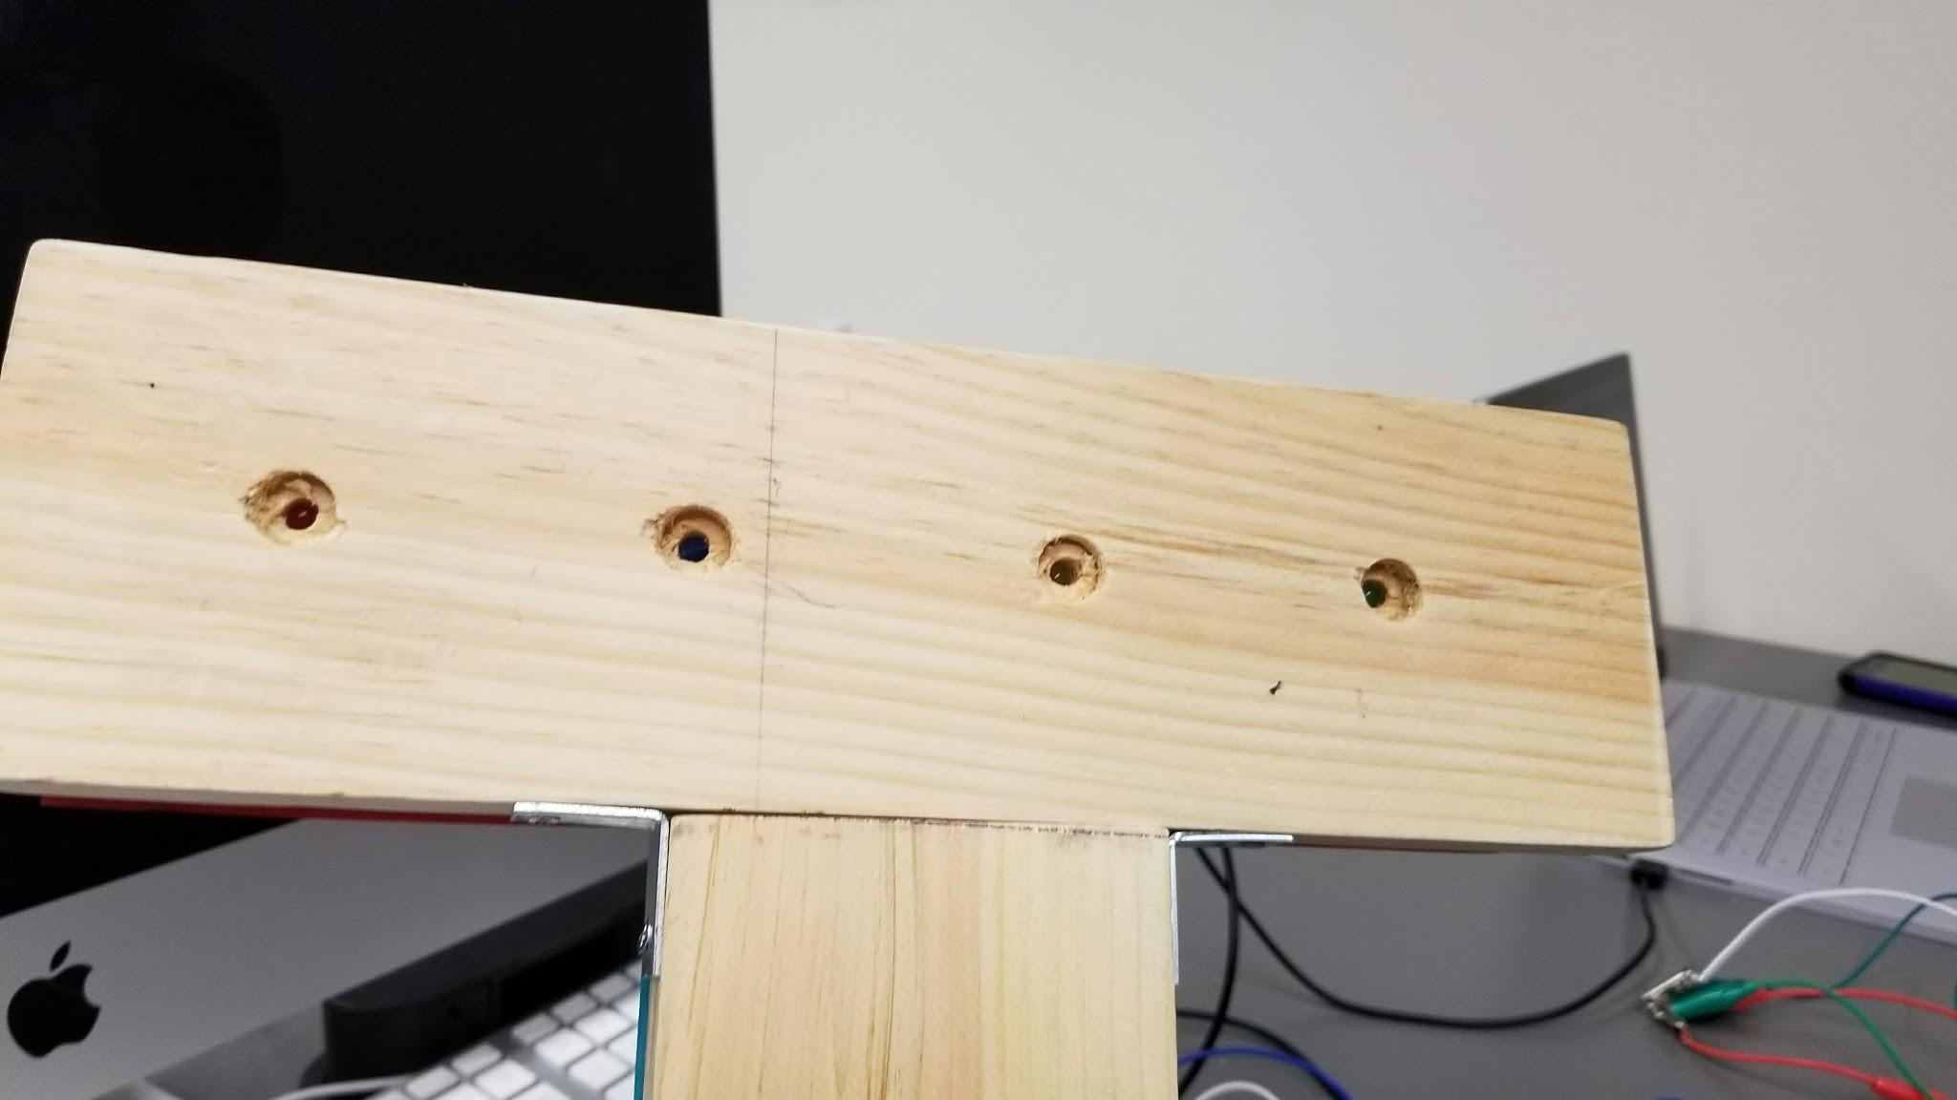
Holes for buttons/LED lights

Slide 6
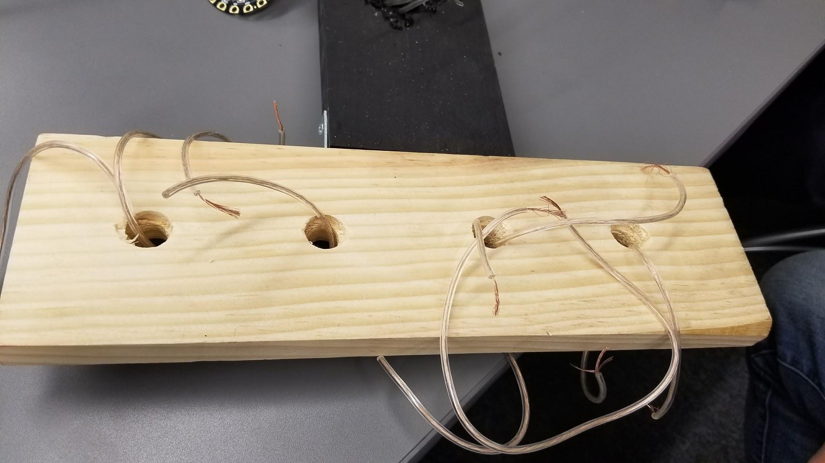
Wires

Slide 7
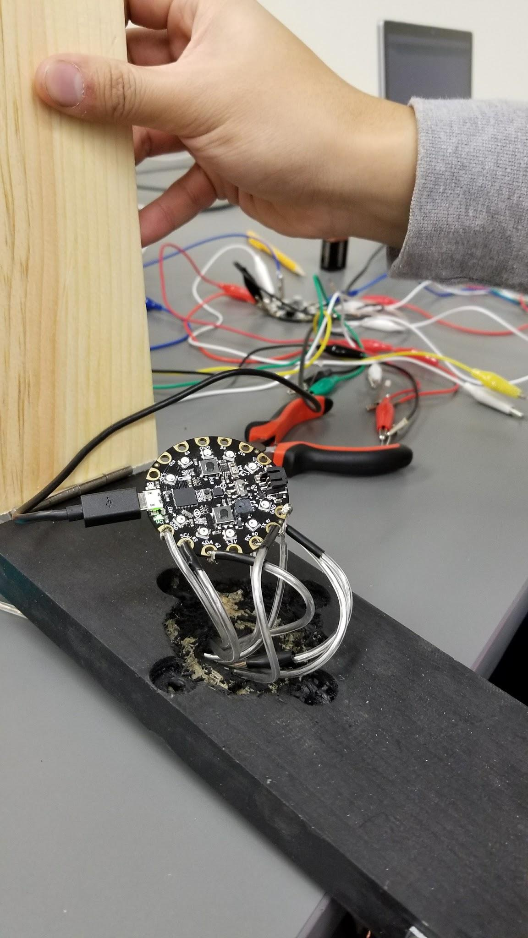
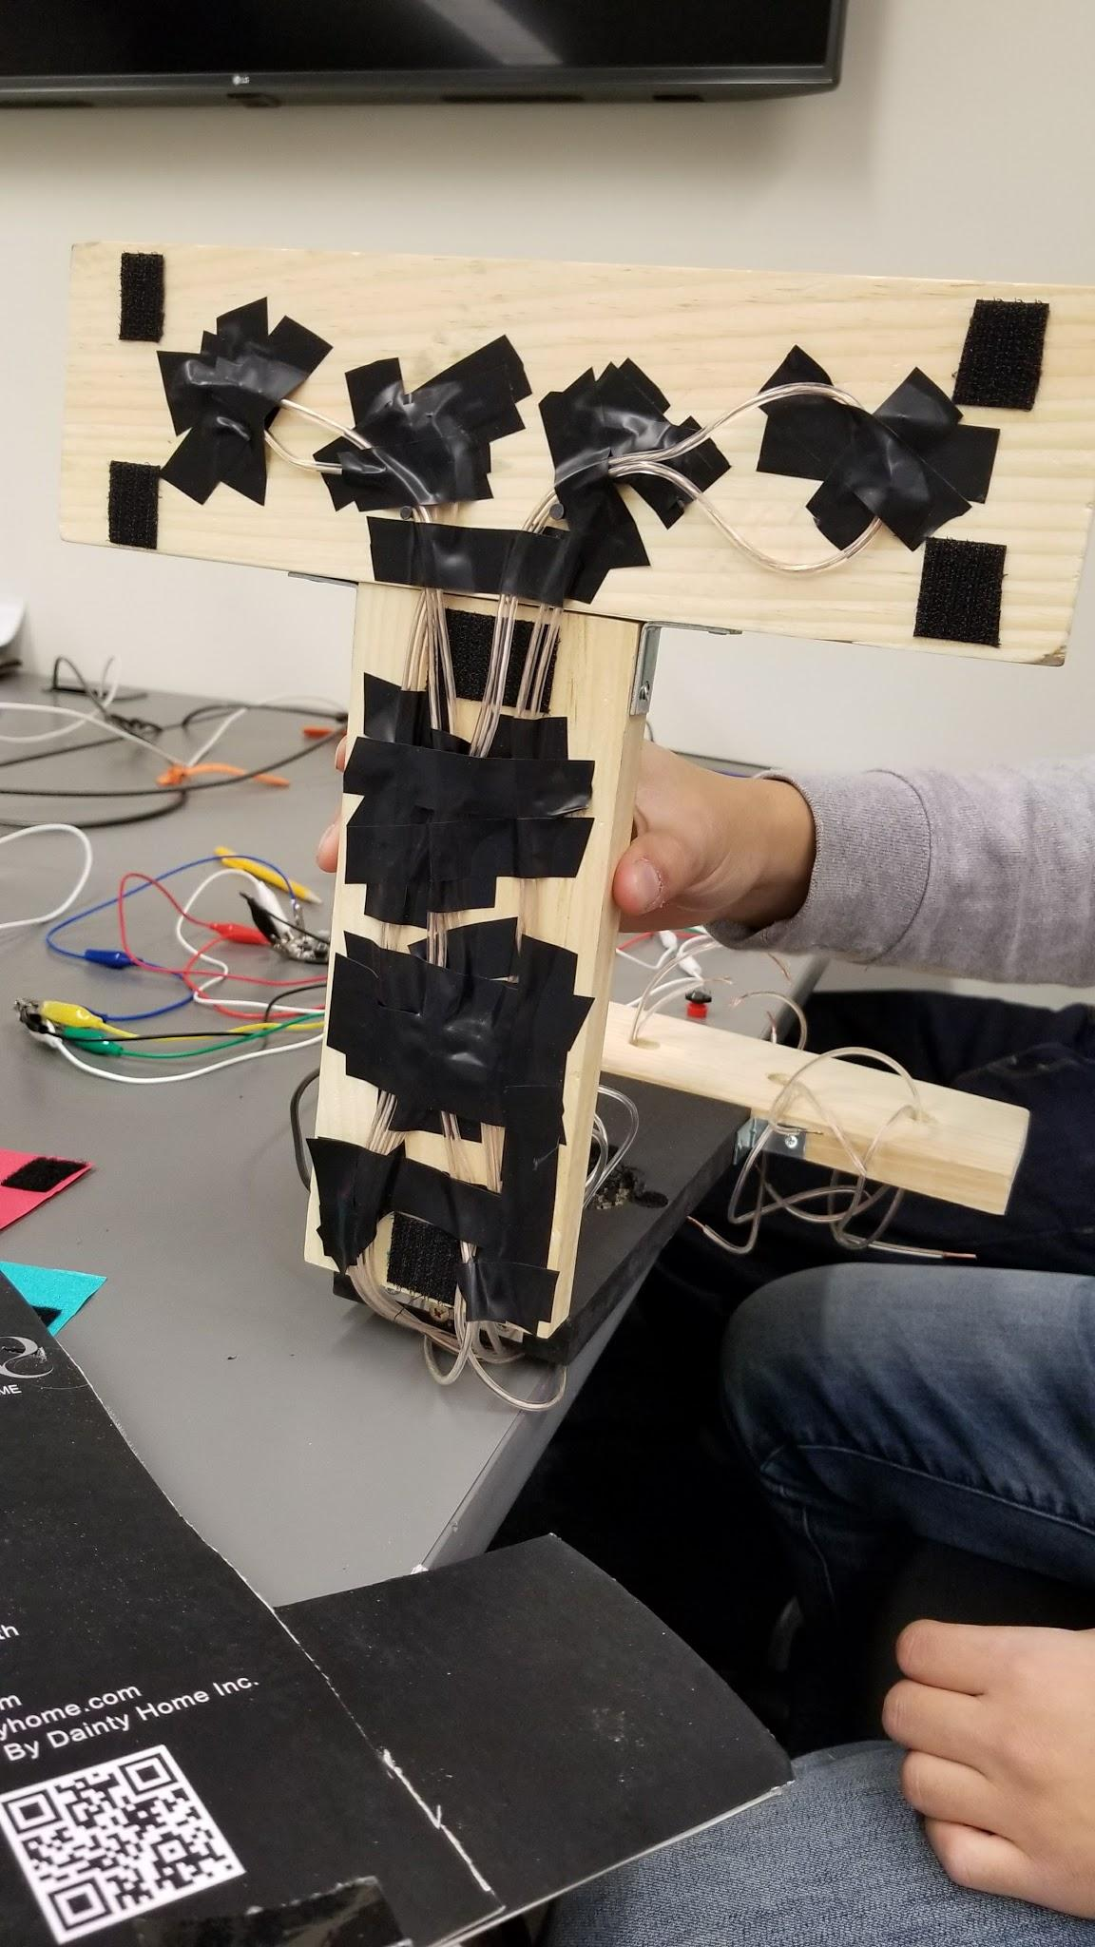
More Wires

Slide 8
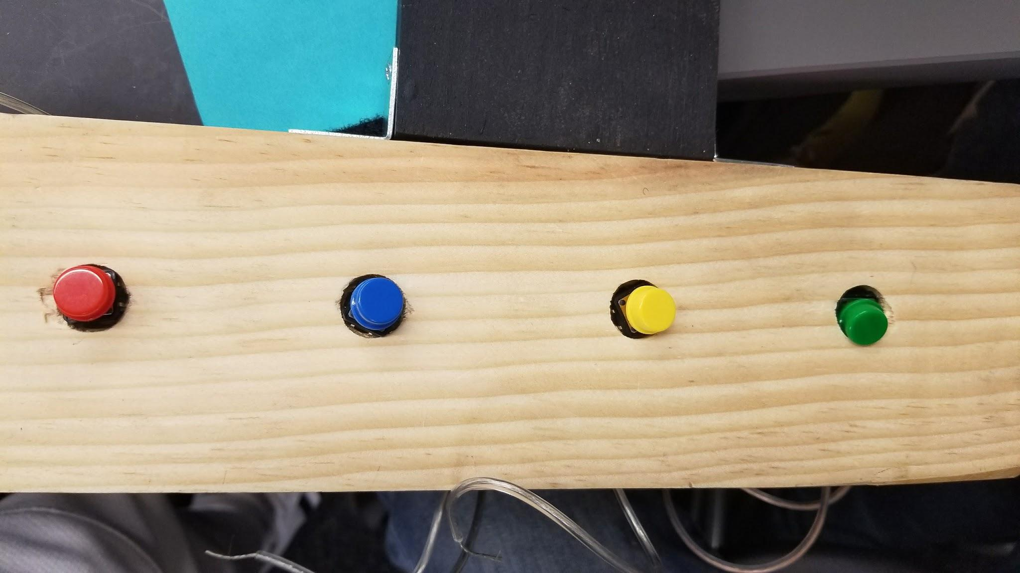
Buttons

Slide 9
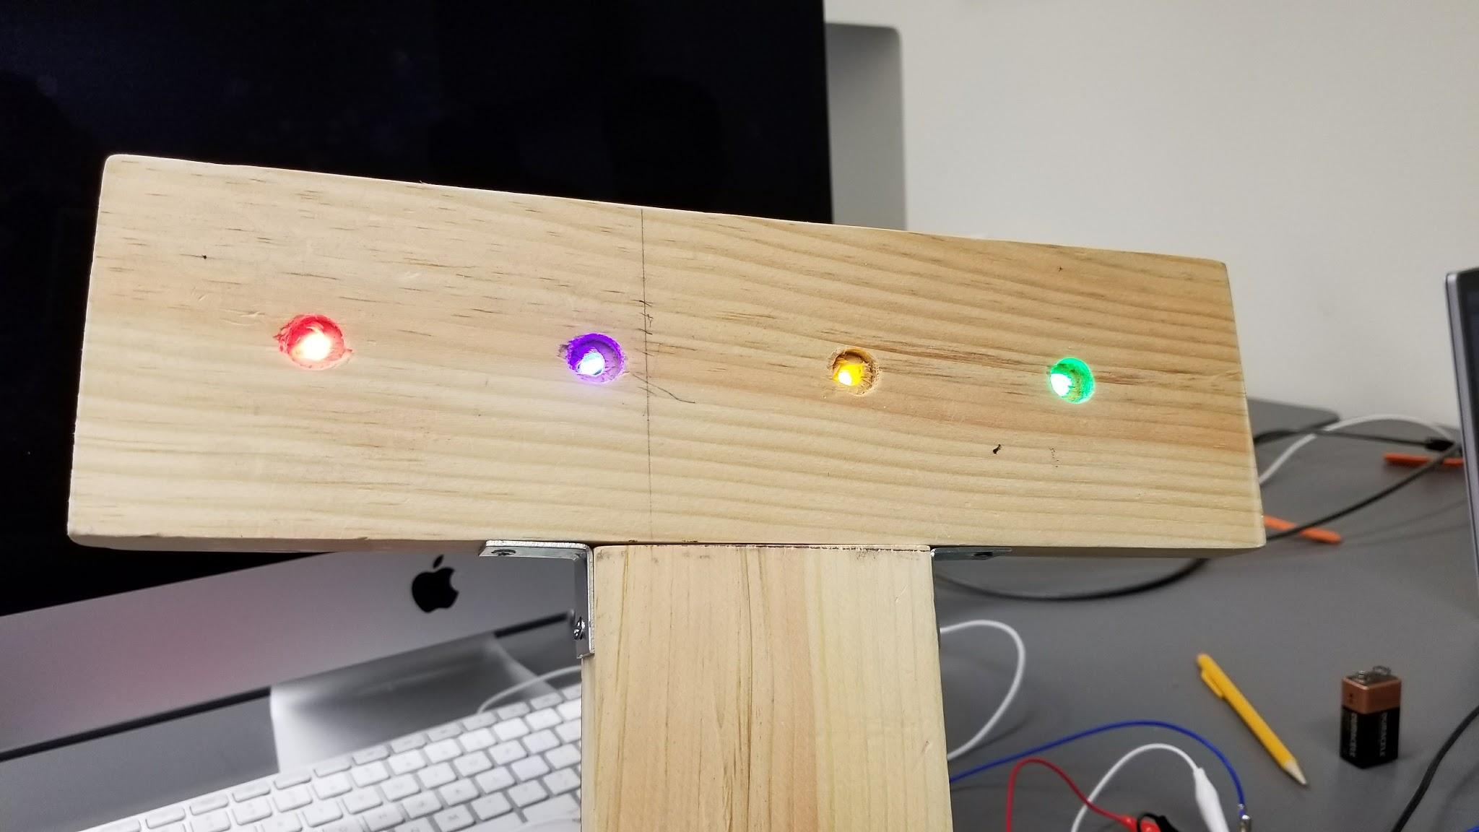
LED lights

Slide 10
Challenges
Figuring out how to switch the Capacitive Touch Pads from inputs to outputs
Figuring out how to use external LEDs and buttons with the Adafruit CircuitPlayground
How to save simons choices
How to check plays input with simon's choices

Slide 11
Credits
Code written by: Deveshwar
Hardware wired/designed by: Gerald

